Slide 1
Sql For Data Science Capstone
Athletes Dataset

Slide 2
Proposal
CUSTOMER:
The aim of this project is to incorporate denotations specifically for client 3: Sportstats. Select your client/dataset - (Olympic Games Dataset - 120 years of data). The database in question will explore the influence of event management attention based on gender, nationality, and other grouping scenarios. Additionally, it will delve into the potential advantages and gains associated with the implementation of a scheduling system. The next step involves categorizing the database into two segments, distinguishing between Summer and Winter Olympic Events. The goal is to examine denotations among athletes, focusing on age, weight, and height, while observing stability in Olympic medal attainment and its impact on athletes.
HYPOTHESES:
Developing a database for a novel client pertaining to participation trends over the last 120 years. We aim to establish a direct correlation through the creation of a sandbox browser programmed in Python, introducing new search criteria to facilitate the analysis of extensive information.
APPROACH:
Conduct an exploratory analysis on athletes from records spanning all Olympic events from the past 120 years to the present. Employ a multifaceted approach in examining athletes within the significant themes of this time period. Identify correlations between athlete gender and similar groups across both Summer and Winter Olympics.

Slide 3
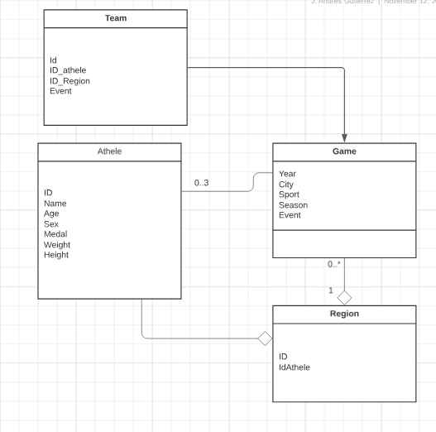
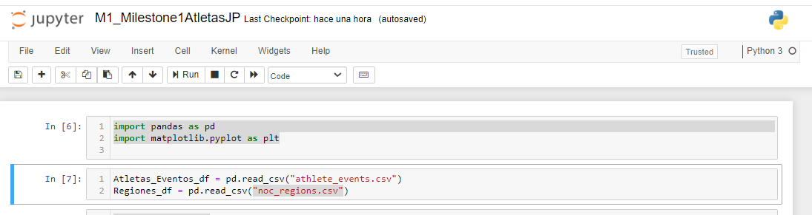
Devolop Sanbox: Develop an Entity Relationship Diagram (ERD)

Slide 4
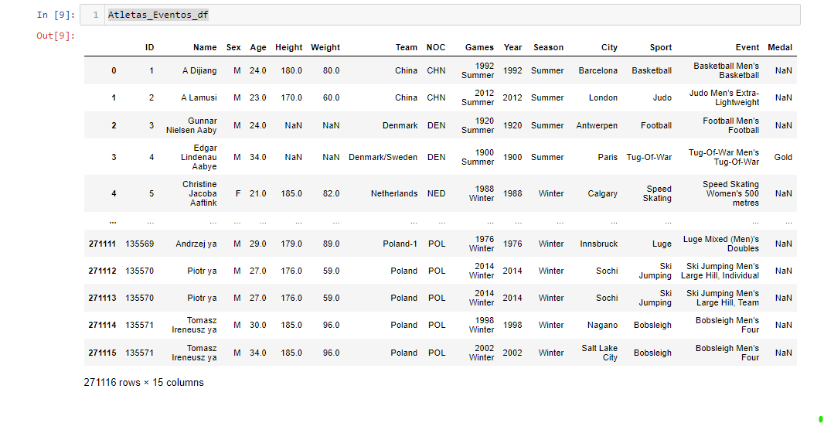
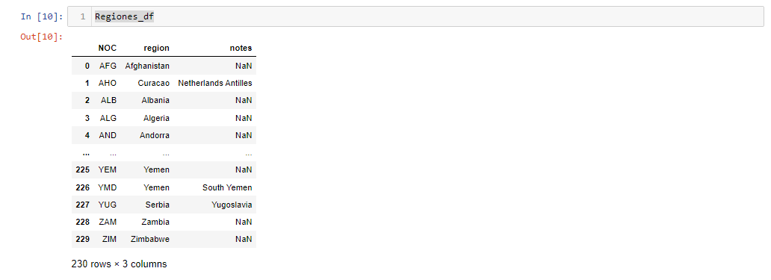
DataBase: Atletas_Eventos Regiones

Slide 5
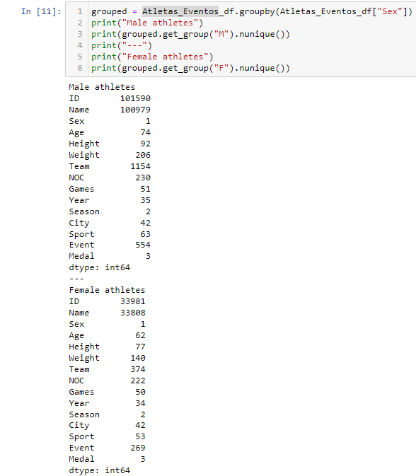
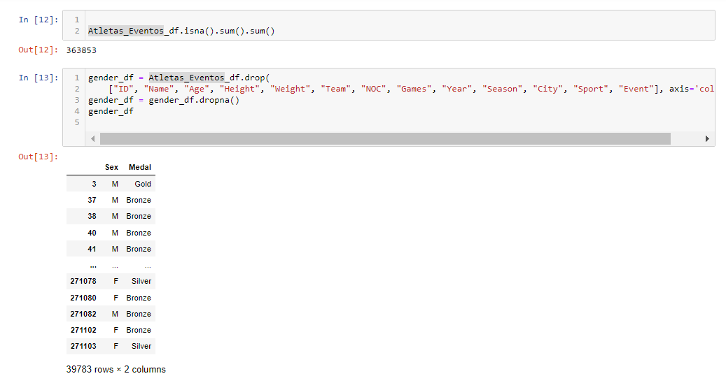
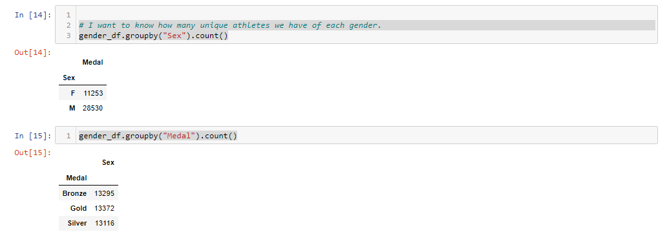
Milestone 1
The initial traceability identification focuses on information within athletes, distinguishing them by gender, grouping their attributes, and analyzing the medals they have earned.

Slide 6
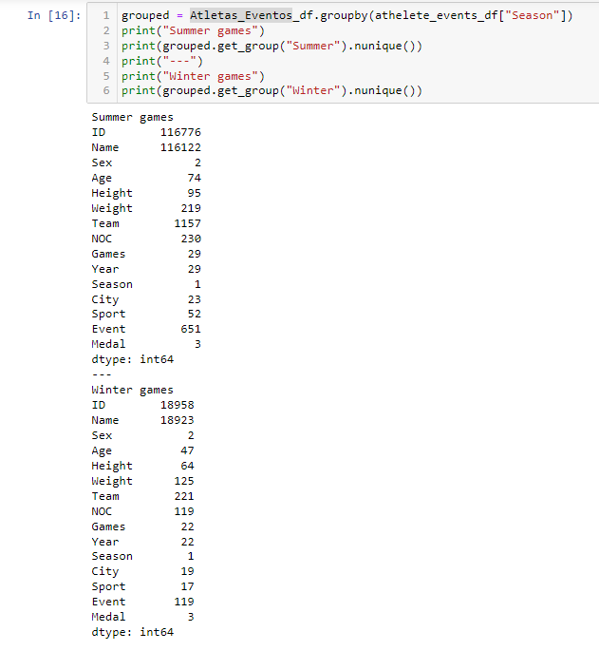
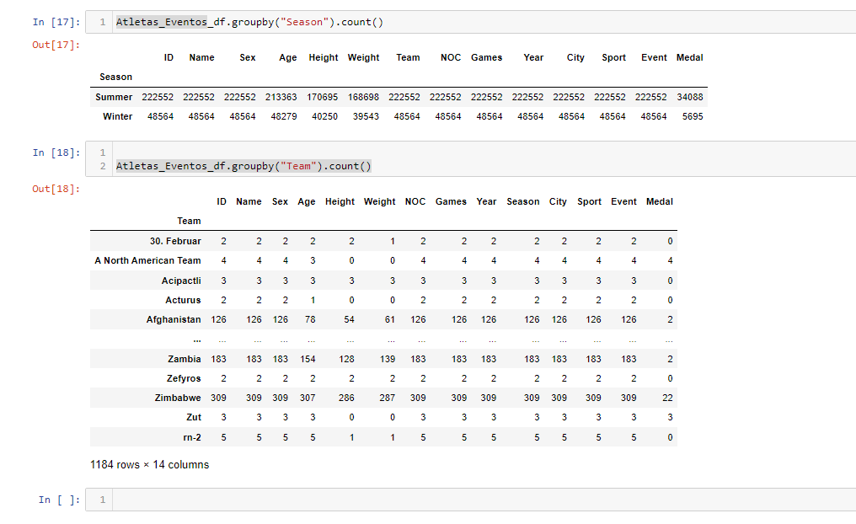
Milestone 2
Before embarking on the second theorem, it is crucial to perform an analysis of the Athletes database, examining the events documented within the "Summer" and "Winter" seasons.

Slide 7
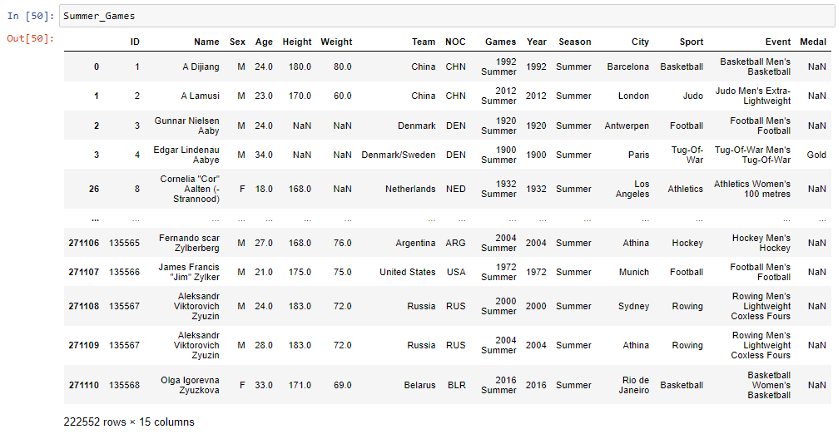
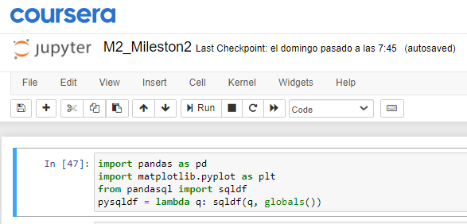
Exploratory Data Analysis: Athletes – Summer and Winter Olympics
Now starting the new laboratory survey, it is necessary to define the information contained in a simplified structure in relation to the "Summer" and "Winter" seasons.
Which will allow us to obtain the requested records.

Slide 8
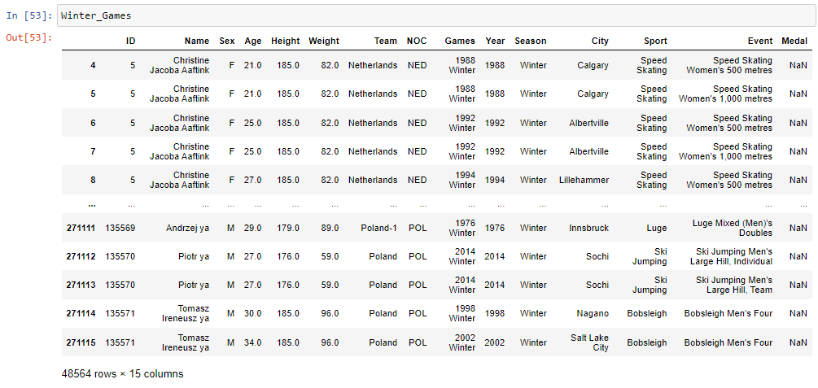
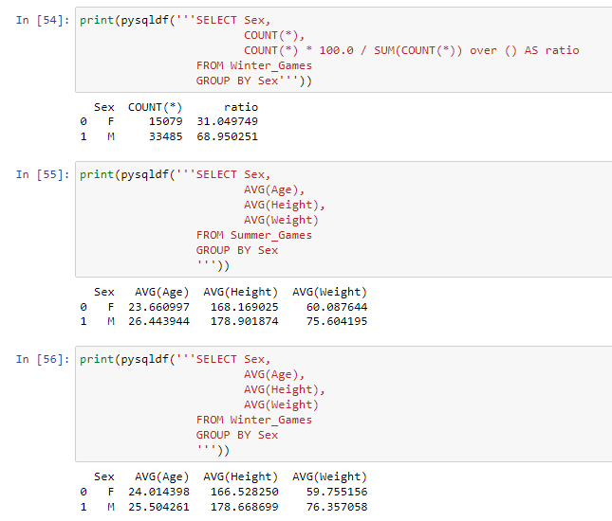

Milestone 2
Which will allow us to obtain the requested records.
A forthcoming study will entail a comprehensive tally and systematic grouping of athletes' attributes, providing a preliminary overview before implementing measurements that will be visualized through graphical structures.

Slide 9
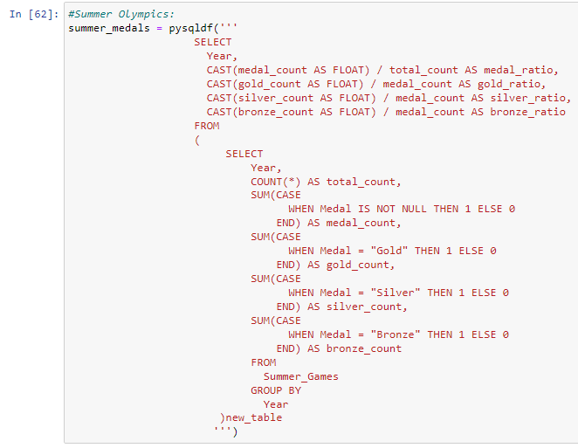

Exploratory Data Analysis: Athletes – Summer and Winter Olympics
Milestone 2
To enhance the understanding for our client and align with actual values across the various Olympic events spanning its inception and evolutionary timeline, we will generate graphs embedded within a new table code.

Slide 10
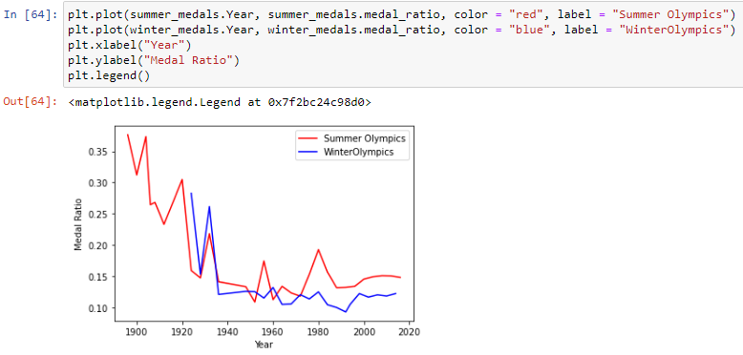
Graphics – Summer and Winter Olympics
in order to provide our client with a more comprehensive perspective and align with authentic values across the numerous Olympic events conducted from its establishment to the present, we will generate graphs incorporated into a new table code.
Milestone 2

Slide 11
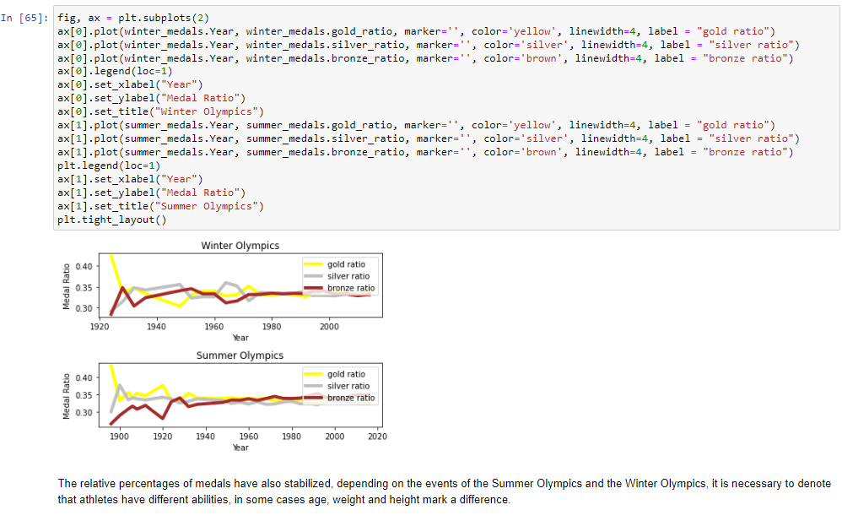
Graphics – Medals

Slide 12
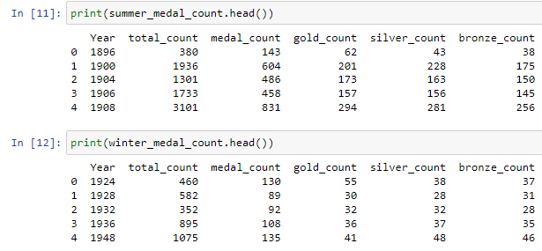
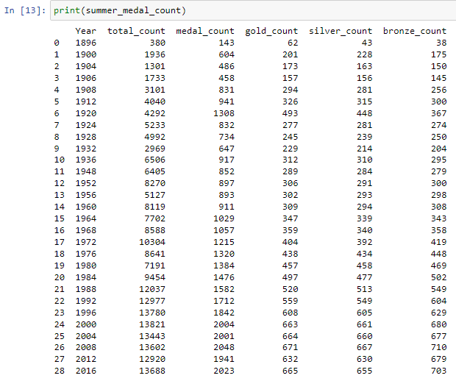
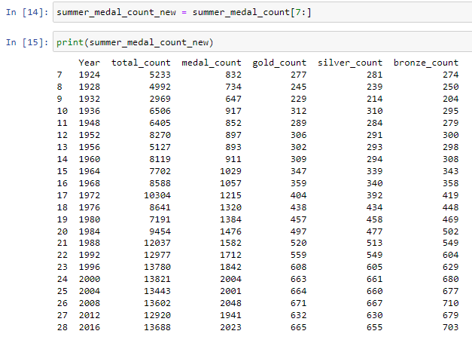
Total Number of Medals

Slide 13
Hypothesis Conclusions
There will be groups of athletes that can be aligned largely based on attributes and medals
There will be defined graphs between these groups from which clients will be able to see the statistics by year concept.
Some themes are representative between time periods.

